Slide 1
Real-Time Traffic Monitoring
Initial draft.
Design and proper structuring of contents will be done later.

Slide 2
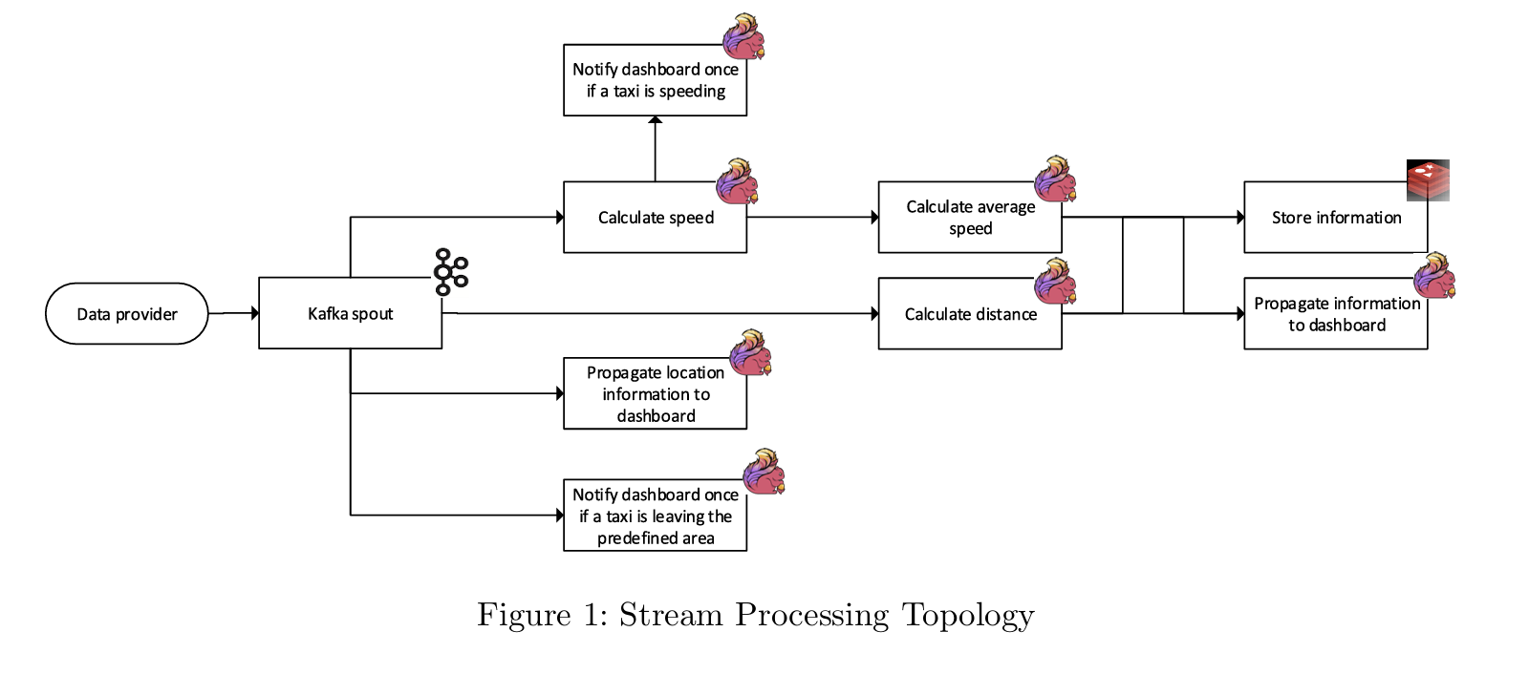

Slide 3
Architecture/Tools

Slide 4
Why these Tools/ Way of working?

Slide 5
Contents to be editted later
Traditional way of working: Collect all data, store in a database and then run batch jobs to analyze and report data
Challenges:
Latency: insights wouldn‘t be in real-time; only seen after processing.
Scalability: Databases may struggle with real-time ingestion from many taxis
Complexity: keeping dashboards updated constantly would require polling and increase load
Harder alerting: Immediate notifications (e.g speeding taxi or boundary violations) would be delayed

Slide 6
Why do we need a database (Redis)

Slide 7
Understanding Taxi Data Architecture
Data Collection
Data is collected from various sources such as GPS devices, fare meters, and passenger apps to support taxi services.
Efficient Data Storage
The architecture must ensure efficient storage of large volumes of data for reliable access and processing.
Real-Time Dispatching
Real-time processing capabilities are crucial for dispatching taxis and managing dynamic operational needs in real-time.
Historical Data Analysis
Historical data is analysed to generate business insights, improve operations, and inform strategic decisions.
Security and Privacy
Ensuring the security and privacy of collected data is critical in designing a robust taxi data architecture.
Notes:
Taxi Data Architecture involves a systematic approach to managing, processing, and analysing data generated by taxi services. It includes components such as data collection from GPS devices, fare meters, and passenger apps. The architecture should ensure efficient data storage, real-time processing for dispatching, and historical data analysis for business insights. Security and privacy are also critical considerations in designing a robust taxi data architecture.

